Slide 1
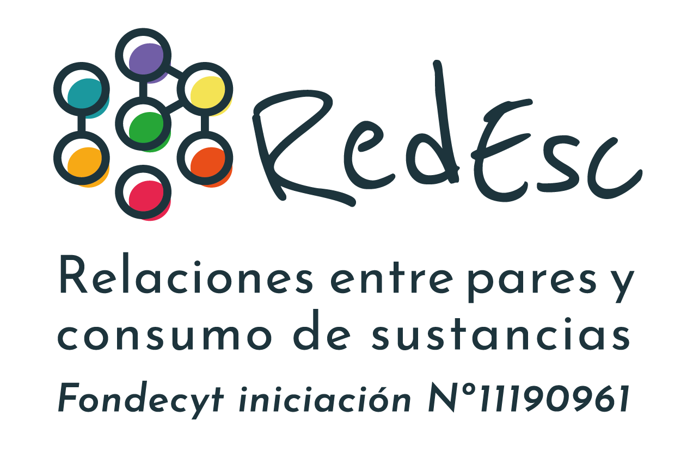
School socioeconomic context and
recent adolescent substance use in Chile:
Who is at higher risk?
Francisca Román Mella^{1,2}, Daniela Palet¹
¹Department of Psychology, Universidad de La Frontera
²Millennium Nucleus for the Evaluation and Analysis of Drug Policies (nDP), Chile

Slide 2
Outline
Background
Literature review
Study aims
Research methods
Results

Slide 3
Adolescent Substance use in Chile (SENDA,2020)
29,8% past month
15,2% past month
15,4% past month
Alcohol use
Tobacco use
Marijuana use
Sustained downward trend in tobacco use since 2005
Slight decrease in alcohol use compared to 2017
Lifetime use doubled between 2005-2015 (14,7% - 34,2%)
Most consumed substance among adolescents and adults
Ban on alcohol sales to underage people (Law Nº21.363)
Ban on smoking indoors in public and commercial places and other restrictions (Law Nº20660, 2013)
​​​​Illicit drugs (Law Nº 20.000): private personal consumption is not sanctioned
Decrease in perceived risk among adolescents

Slide 4
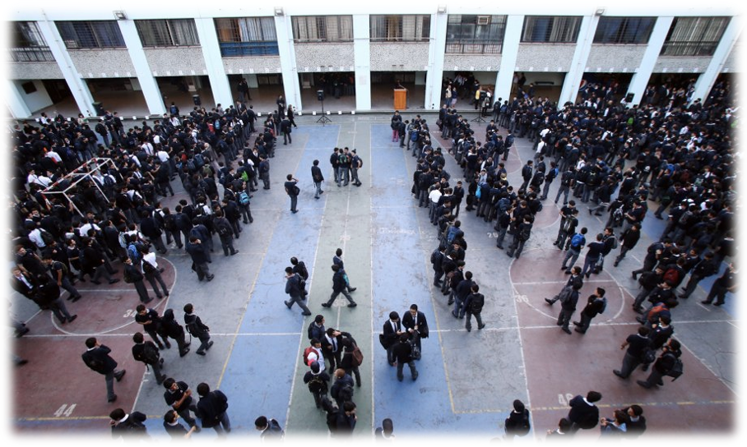
School socioeconomic segregation in Chile
Pro-market oriented economic system in Chile
Socioeconomic segregation in the education system
Social exclusion
Educational attainment
Access to higher education
Valenzuela et al. (2013); Larranaga & Sanhueza (2007)

Slide 5
Outline
Background
Literature review
Study aims
Research methods
Results

Slide 6
School socioeconomic context and adolescent substance use
Alcohol
Tobacco
Marijuana
High school SES
Higher rates/risk of alcohol use
Low
school SES
Higher rates/risk of tobacco use
Low
school SES
Higher rates/risk of marijuana use
Andrade (2013); Botticello (2009); Gaete & Araya (2017); Kim et al. (2006); Olsson & Fritzell (2015); O’Malley et al. (2006)
Dunn et al. (2015); Linetzky et al. (2012); Mehanović et al. (2020); Moore et al. (2015); Pearson et al. (2006); Wallace et al. (2009)
Matteau-Pelletier et al. (2020); Ryabov (2015)
Differences between the studies
Different measures of substance use
Adjustment approach
Insufficient adjustment for individual characteristics
Over-adjustment for potential mediators
Analysis did not take into account clustering of the observations
Results may depend on characteristics of national schooling system

Slide 7
Substance use and gender
Gender differences in substance use
Social beliefs regarding gender roles and norms
Boys encouraged to engage in riskier behaviours and girls to internalize social norms
Gender differences in substance use
Alcohol: Gender differences are narrowing and even cases of girls reporting greater consumption than boys
Tobacco: More frequent in girls than boys
Marijuana: More frequent in boys than girls
Gender and school SES
A few studies have shown school SES effect varies according to gender
Andrade (2013); Evans (2019); Gaete (2017); Hoffman (2006); Linetsky et al. (2012); MacArthur et al. (2012); Matteau-Pelletier, et al. (2020); Nolen-Hoeksema, (2004); Pearson et al. (2006)

Slide 8
Study Aims
To examine the associations between school socioeconomic context and recent substance use among Year 8 (Y8) and Year 10 (Y10) students and whether these associations differ by gender

Slide 9
Outline
Background
Literature review
Study aims
Research methods
Results

Slide 10
Research methods
Data Sources
Participants
Year 8 (2017)
91,220 adolescents from 8,367 school classes and 5,714 schools
50.1% girls
School SES: 23.3% low; 33.6% lower middle; 24.3% middle; 11.4% upper middle; 7.4% high
Year 10 (2018)
164,693 adolescents from 7,119 school classes and 2,922 schools
50.8% girls
School SES: 24.6% low; 29.2% lower middle; 21.5% middle; 11.7% upper middle; 12.9% high
Individual-level variables
Data were collected through the Educational Quality Assessment
System (SIMCE) applied annually to students at national level.
Students completed Quality and Context of Education questionnaire in Year 8 (2017) and Year 10 (2018)
Parents’ questionnaire
School-level variables
Information was obtained from the Ministry of Education

Slide 11
Variables
Reported by students
School information
Outcomes
Past-month substance use
“During the last month, how often have you been involved in the following behaviours?”
Drinking alcohol / Smoking cigarettes / Smoking marijuana
School SES
School socioeconomic classification provided by the Ministry of Education and based on %FSM and information reported by parents on income and education
Low / Lower middle / Middle /
Upper middle / High
Response options | Dichotomized scale
Never or almost never | Never or almost never
Rarely | Once or more
Many times
Always or almost always
Reported by parents
Covariates
Parents' education: Highest educational attainment of the father or mother
Covariates
Gender (male/female)

Slide 12
Analytical plan
Multilevel modelling
•Hierarchical structure of data
•Individuals – school classes – schools
Multilevel logistic regression
Drinking / smoking / marijuana use
Once or more vs. never/almost never
Interaction between School SES and gender
•Interaction terms
Adjustment approach
Child’s gender and parents’ education
Predicted probabilities Calculated based on fixed effects using margins
Software
•Stata 17

Slide 13
Outline
Background
Literature review
Study aims
Research methods
Results

Slide 14
Substance use by school year
 | Year 8 n=91,220 | Year 10 n=164,693
Alcohol | 14.5% (14.3; 14.7) | 34.6%; (34.4; 34.8)
Tobacco | 7.5% (7.3; 7.7) | 15.7%; (15.5, 15.9)
Marijuana | 6.1% (6.0; 6.2) | 13.7%; (13.5, 13.9)

Slide 15
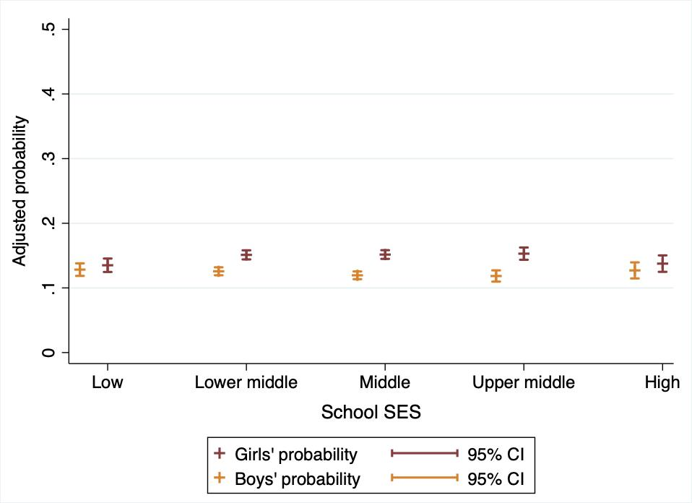
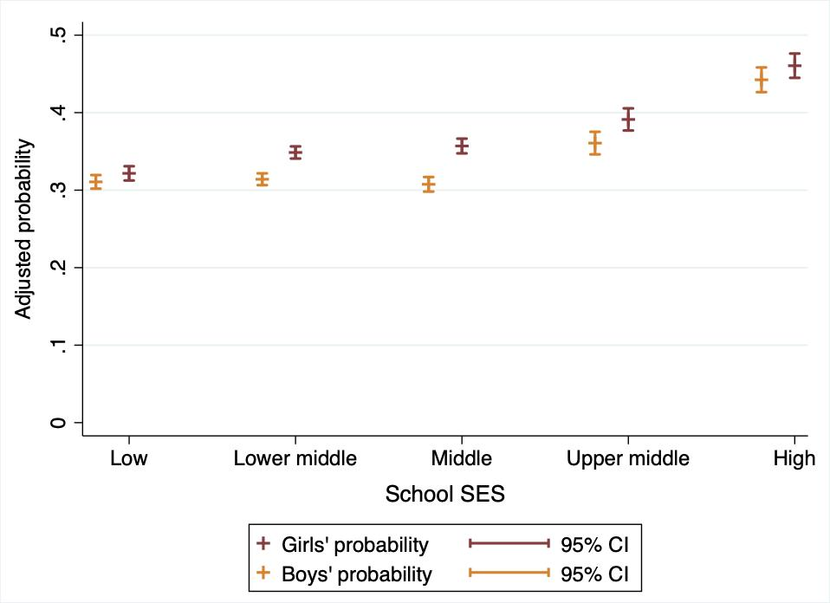
School SES and recent alcohol use
Year 8, 2017
Year 10, 2018

Slide 16
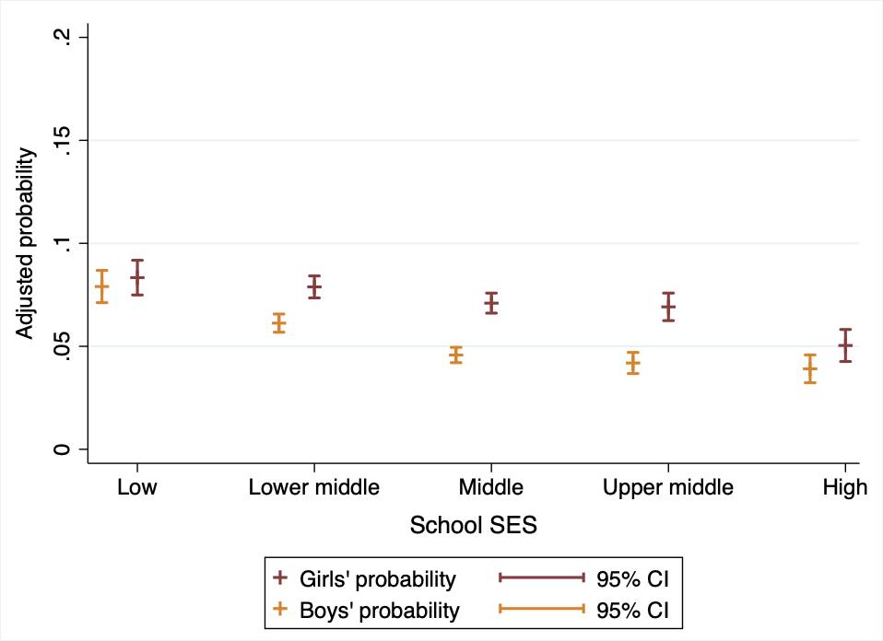
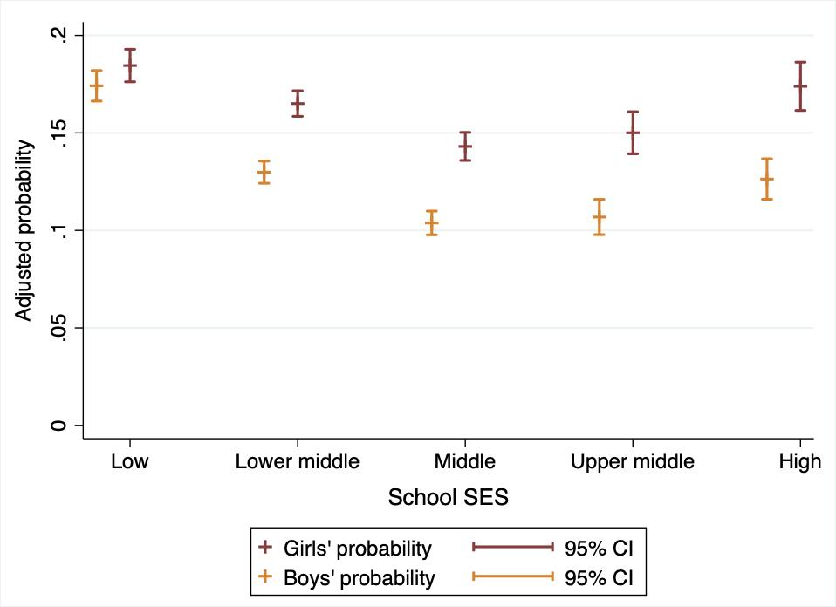
School SES and recent smoking
Year 8, 2017
Year 10, 2018

Slide 17
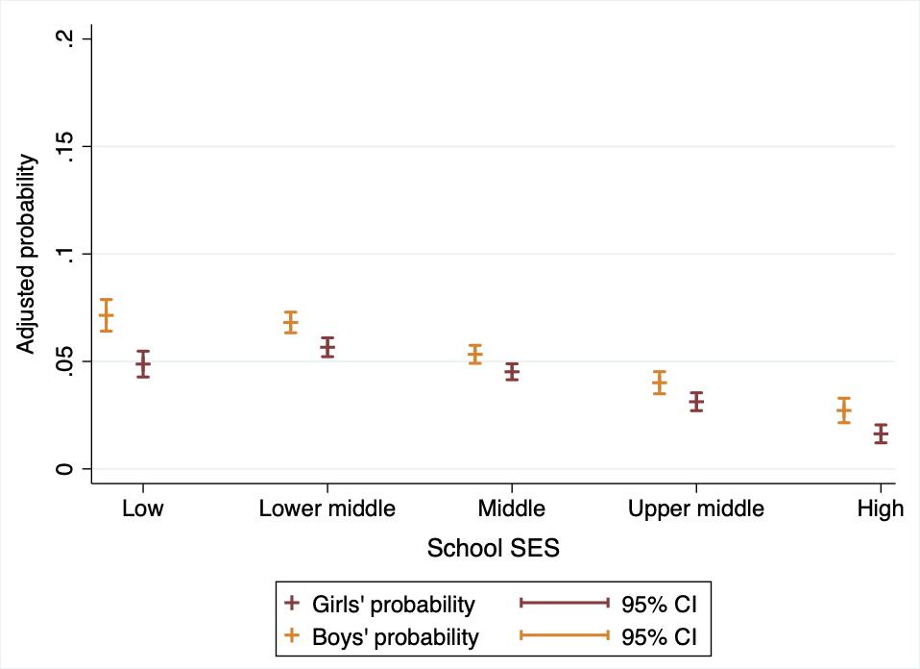
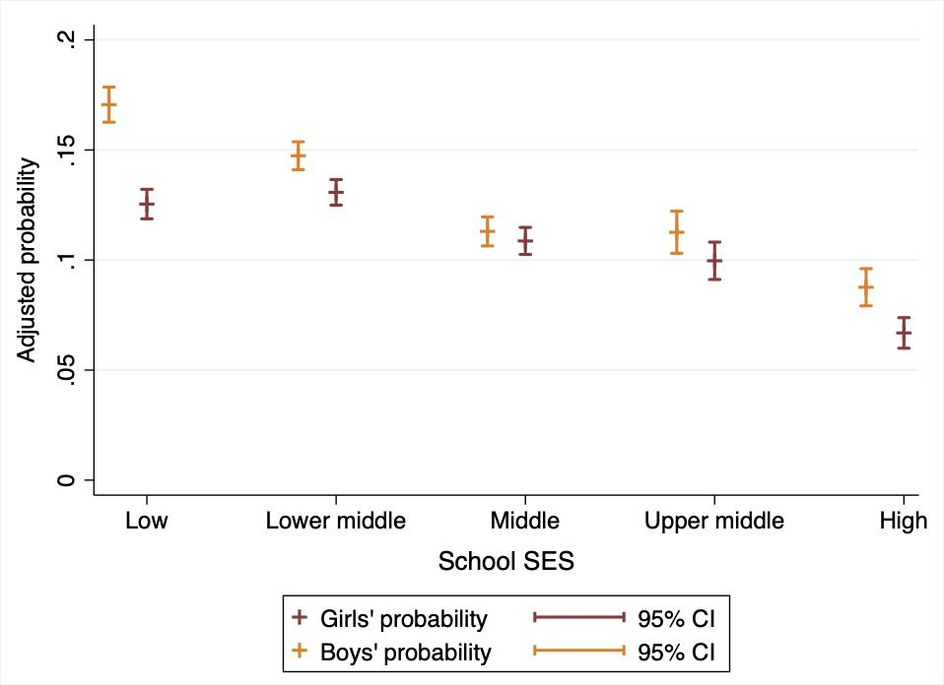
School SES and recent marijuana use
Year 8, 2017
Year 10, 2018

Slide 18
Conclusions
The influence of school socioeconomic context on adolescent substance use seems to differ depending on the substance consumed, gender and school year
Alcohol use
Y8 → School SES unrelated to drinking among boys
Y10 → Boys and girls attending more affluent schools at higher risk of recent alcohol use
Andrade (2013); Botticello (2009); Gaete & Araya (2017); Kim et al. (2006); Olsson & Fritzell (2015); O’Malley et al. (2006)

Slide 19
Conclusions
Tobacco use
Y8 and Y10 → Boys attending the most socially deprived schools are at higher risk of smoking than boys from other SES schools
Girls are at higher risk of smoking than boys
Marijuana use
Y8 and Y10 → Boys attending the most socially deprived schools are at higher risk of marijuana use than those from other SES schools
Boys are more likely to be involved in marijuana use than girls
Dunn et al. (2015); Gaete (2017); Linetzky et al., 2012; MacArthur et al. (2012); Mehanović et al. (2020); Moore et al., 2015; Pearson et al. (2006); Ryabov (2015); Wallace et al. (2009)

Slide 20
Conclusions
Drinking alcohol, smoking cigarettes and using marijuana seem to be socioeconomically patterned at school level
Results mirror previous findings showing that students attending more affluent schools tend to be more likely to drink, but those attending less affluent schools tend to be more likely to smoke and consume marijuana.
Tackling underage substance use in Chile would require a multilevel approach, intervening at community and school level

Slide 21
References
Mehanović, E., Mathis, F., Brambilla, R., Faggiano, F., Galanti, M. R., Vigna-Taglianti, F., Zunino, B., Cuomo, G. L., Vadrucci, S., Salmaso, S., Bohrn, K., Bohrn, S., Coppens, E., Weyts, Y., van der Kreeft, P., Jongbloet, J., Melero, J. C., Perez, T., Varona, L., … Scatigna, M. (2020). Do the socioeconomic context and the European geographical area modify parental influences on smoking experimentation among adolescents? European Child and Adolescent Psychiatry, 0123456789. https://doi.org/10.1007/s00787-020-01489-5
Melotti R, Lewis G, Hickman M, Heron J, Araya R, Macleod J. (2013). Early life socio-economic position and later alcohol use: birth cohort study. Addiction, 108(3):516-25.
Moore, G. F., & Littlecott, H. J. (2015). School- and family-level socioeconomic status and health behaviors: Multilevel analysis of a national survey in wales, United Kingdom. Journal of School Health, 85(4), 267–275. https://doi.org/10.1111/josh.12242
Nolen-Hoeksema S.(2004). Gender differences in risk factors and consequences for alcohol use and problems. Clin Psychol Rev., 24(8), 981-1010.
Olsson G, Fritzell J. (2016). Family Composition and Youth Health Risk Behaviors: the Role of Patental Relation and the School Context. Child Indicators Research, 10(2), 403-421
O’Malley, P. M., Johnston, L. D., Bachman, J. G., Schulenberg, J. E., & Kumar, R. (2006). How substance use differs among American secondary schools. Prevention Science, 7(4), 409–420. https://doi.org/10.1007/s11121-006-0050-5
Observatorio Chileno de Drogas. (2019). Décimo Tercer Estudio Nacional de Drogas en Población Escolar: PRINCIPALES RESULTADOS. Ministerio Del Interior y Seguridad Pública. https://www.senda.gob.cl/principales-resultados-del-decimo-tercer-estudio-nacional-de-drogas-en-poblacion-escolar-2019/%0Ahttps://www.senda.gob.cl/wp-content/uploads/2021/01/ENPE-2019.pdf
Pearson, M., Sweeting, H., West, P., Young, R., Gordon, J., & Turner, K. (2006). Adolescent substance use in different social and peer contexts: A social network analysis. Drugs: Education, Prevention and Policy, 13(6), 519–536. https://doi.org/10.1080/09687630600828912
Roche KM, Ahmed S, Blum RW. (2008). Enduring consequences of parenting for risk behaviors from adolescence into early adulthood. Soc Sci Med., 66(9) 2023-34.
Román, F. (2017). Adolescent Drinking In Chile: The Role Of School Socioeconomic Environment In Relation To Parental And Peer Influences. University College London.
Ryabov, I. (2015). Relation of peer effects and school climate to substance use among Asian American adolescents. Journal of Adolescence, 42, 115–127. https://doi.org/10.1016/j.adolescence.2015.04.007
Valenzuela JP, Bellei C, de los Ríos D. (2013). Socioeconomic school segregation in a market-oriented educational system. The case of Chile. Journal of Education Policy, 29(2), 217-241
SENDA, S. N. para la P. y R. del consumo de D. y A. (2019). Décimo Tercer Estudio Nacional de Drogas en Población General de Chile, 2018 (Issue 1). https://www.senda.gob.cl/wp-content/uploads/2020/02/ENPEG-2018.pdf
Valenzuela J, Bellei C, de los Ríos D. (2013). Socioeconomic school segregation in a market-oriented educational system. The case of Chile. Journal of Education Policy, 1-25.
Wallace, J. M., Vaughn, M. G., Bachman, J. G., O’Malley, P. M., Johnston, L. D., & Schulenberg, J. E. (2009). Race/ethnicity, socioeconomic factors, and smoking among early adolescent girls in the United States. Drug and Alcohol Dependence, 104(SUPPL. 1), 42–49. https://doi.org/10.1016/j.drugalcdep.2009.06.007
Andrade, F. H. (2013). Can the school context moderate the protective effect of parental support on adolescents’ alcohol trajectories in urban Chicago? Drug and Alcohol Dependence, 133(2), 330–337. https://doi.org/10.1016/j.drugalcdep.2013.06.010
Bendtsen P, Damsgaard MT, Huckle T, Casswell S, Kuntsche E, Arnold P, et al. (2014). Adolescent alcohol use: a reflection of national drinking patterns and policy?, Addiction, 109(11):1857-68.
Botticello, A. L. (2009). School contextual influences on the risk for adolescent alcohol misuse. American Journal of Community Psychology, 43(1–2), 85–97. https://doi.org/10.1007/s10464-008-9226-4
Departamento de Epidemiología División de Planificación Sanitaria Subsecretaría de Salud Pública Ministry of Health (Chile). (2017). Encuesta Nacional de Salud 2016-2017 Primeros resultados. http://web.minsal.cl/wp-content/uploads/2017/11/ENS-2016-17_PRIMEROS-RESULTADOS.pdf
Dunn, E. C., Richmond, T. K., Milliren, C. E., & Subramanian, S. V. (2015). Using cross-classified multilevel models to disentangle school and neighborhood effects: An example focusing on smoking behaviors among adolescents in the United States. Health and Place, 31, 224–232. https://doi.org/10.1016/j.healthplace.2014.12.001
Evans, C. R. (2019). Reintegrating contexts into quantitative intersectional analyses of health inequalities. Health and Place, 60(June), 102214. https://doi.org/10.1016/j.healthplace.2019.102214
Gaete, J., & Araya, R. (2017). Individual and contextual factors associated with tobacco, alcohol, and cannabis use among Chilean adolescents: A multilevel study. Journal of Adolescence, 56, 166–178. https://doi.org/10.1016/j.adolescence.2017.02.011
Giesbrecht N, Spagg JC, Pemjean A, Marquez J, Khenti A, Rehm J, et al. (2013)A national alcohol strategy for Chile: Rationale, development, content and status of implementation. The International Journal of Alcohol and Drug Research, 2(2):17-29.
Hoffmann, J.P., 2006. Extracurricular activities, athletic participation, and adolescent alcohol use: Gender-differentiated and school-contextual effects. J. Health Soc. Behav. 47(3), 275–290
Kim, J., & McCarthy, W. J. (2006). School-level contextual influences on smoking and drinking among Asian and Pacific Islander adolescents. Drug and Alcohol Dependence, 84(1), 56–68. https://doi.org/10.1016/j.drugalcdep.2005.12.004
Larranaga O, Sanhueza C. (2007). Residential segregation effects on Poor's opportunities in Chile. Santiago, Chile: Departamento de Economia, Universidad de Chile.
Linetzky, B., Mejia, R., Ferrante, D., De Maio, F. G., & Diez Roux, A. V. (2012). Socioeconomic status and tobacco consumption among adolescents: A multilevel analysis of Argentina’s global youth Tobacco survey. Nicotine and Tobacco Research, 14(9), 1092–1099. https://doi.org/10.1093/ntr/nts004
MacArthur, G. J., Smith, M. C., Melotti, R., Heron, J., MacLeod, J., Hickman, M., Kipping, R. R., Campbell, R., & Lewis, G. (2012). Patterns of alcohol use and multiple risk behaviour by gender during early and late adolescence: The ALSPAC cohort. Journal of Public Health, 34(SUPPL. 1), 20–30. https://doi.org/10.1093/pubmed/fds006
Margozzini P, Sapag JC. (2015). El consumo riesgoso de alcohol en Chile: tareas pendientes y oportunidades para las políticas públicas [Harmful drinking in Chile: tasks and oppotunities for public policy]. Temas de la Agenda Publica, 10(75):1-15.
Matteau-Pelletier, L., Bélanger, R. E., Leatherdale, S., Desbiens, F., & Haddad, S. (2020). Sex-Related Differences in Adolescent Cannabis Use: Influences of School Context and School Connectedness. Journal of School Health, 90(11), 878–886. https://doi.org/10.1111/josh.12950

Slide 22
